Slide 1

ROCKBUSTER STEALTH LLC
DATA ANALYSIS
Lance Garcia
Presentation link

Slide 2
PROJECT GOALS
Rockbuster Stealth LLC is formerly a well-renown move rental company that’s struggling due to the rise of streaming competitors such as Netflix and Amazon Prime.
The objective is to pivot towards an online streaming rental service to reclaim territory in the extremely competitive streaming environment.

Slide 3
KEY INQUIRIES
How are customers distributed across different countries and what is the total revenue generated in each of these countries?
Who are the top individual spenders among all customers?
What are the most popular genres?
Does the availability of movies in certain genres correlate with higher revenue or rental rates?
How can we extrapolate these insights to improve upon the current Rockbuster business model?

Slide 4





DATA OVERVIEW
1000 Movie Titles 17 Genres 108 Countries
599 Customers $61,312 Total Revenue

Slide 5
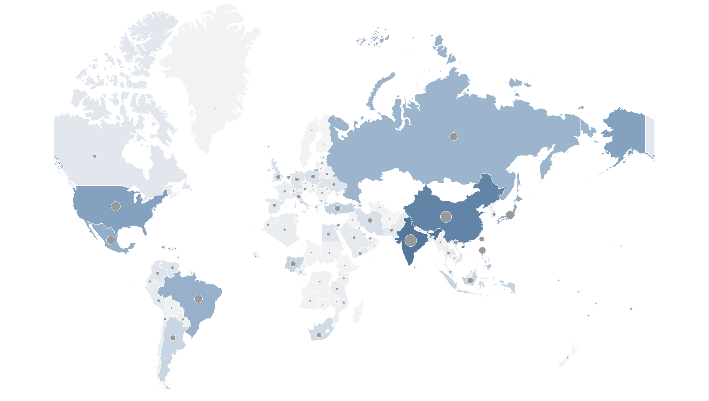
MARKET ANALYSIS: TOP REVENUE GENERATING COUNTRIES
Rockbuster has customers in 108 countries across the globe. Additionally, we operate in 600 cities in those countries.
Thanks to our 599 customers all over the world, we have generated $61,312 in revenue for Rockbuster.
Among these countries, India, China, the United States, Japan and Mexico lead the pack in revenue with a combined $21,078.
These top 5 countries are also boast the highest customer counts at 60, 53, 36, 31 and 30, respectively.

Slide 6
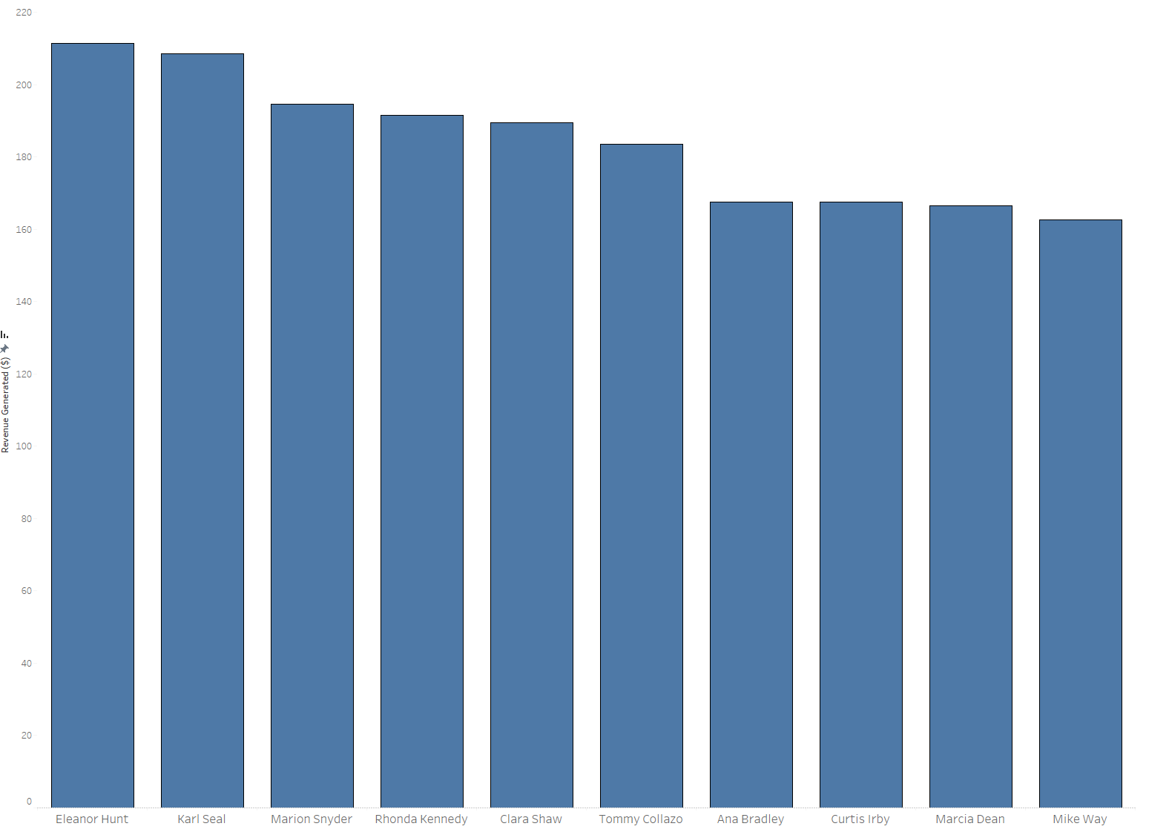
HIGH VALUE CLIENTELE: ROCKBUSTER’S BEST
Among all 599 Rockbuster customers, these are the top 10 spenders. Collectively, they’ve contributed $1844 in revenue.

Slide 7
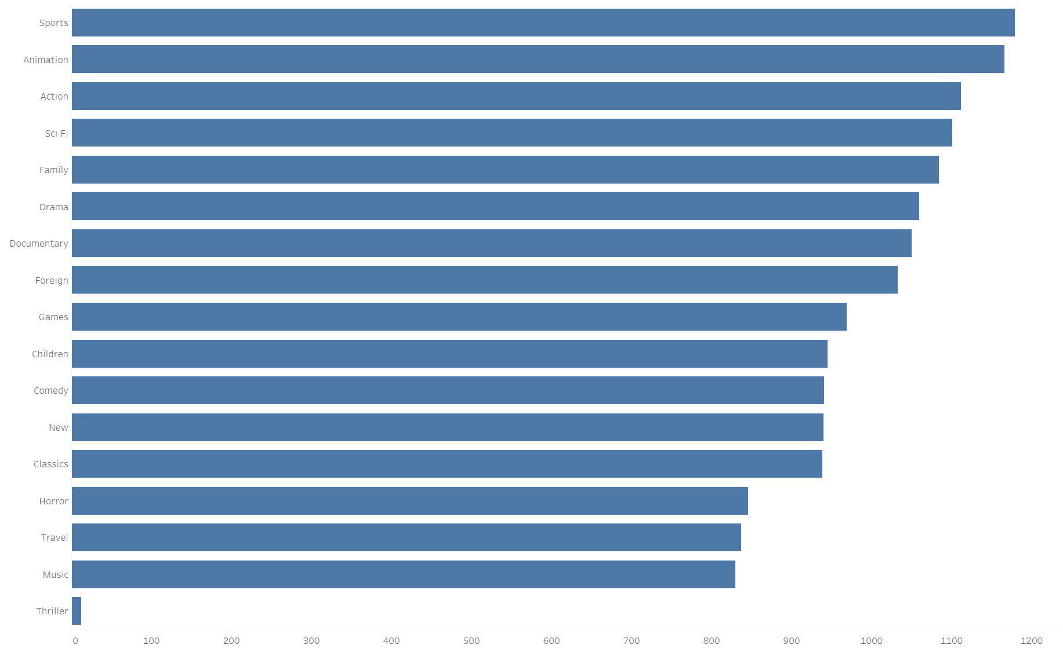
AUDIENCE PICKS: GENRE POPULARITY BY RENTALS
According to rental figures, sports and animation movies are the most popular.

Slide 8
MOVIE/RENTAL DETAIL BREAKDOWN
Regarding rental duration, the shortest is 3 days, the average is 5 days and the longest is 7 days.
Regarding rental rate, the least is $1, the average is $3, and the most is $5.
On average revenue from customers is $102.

Slide 9
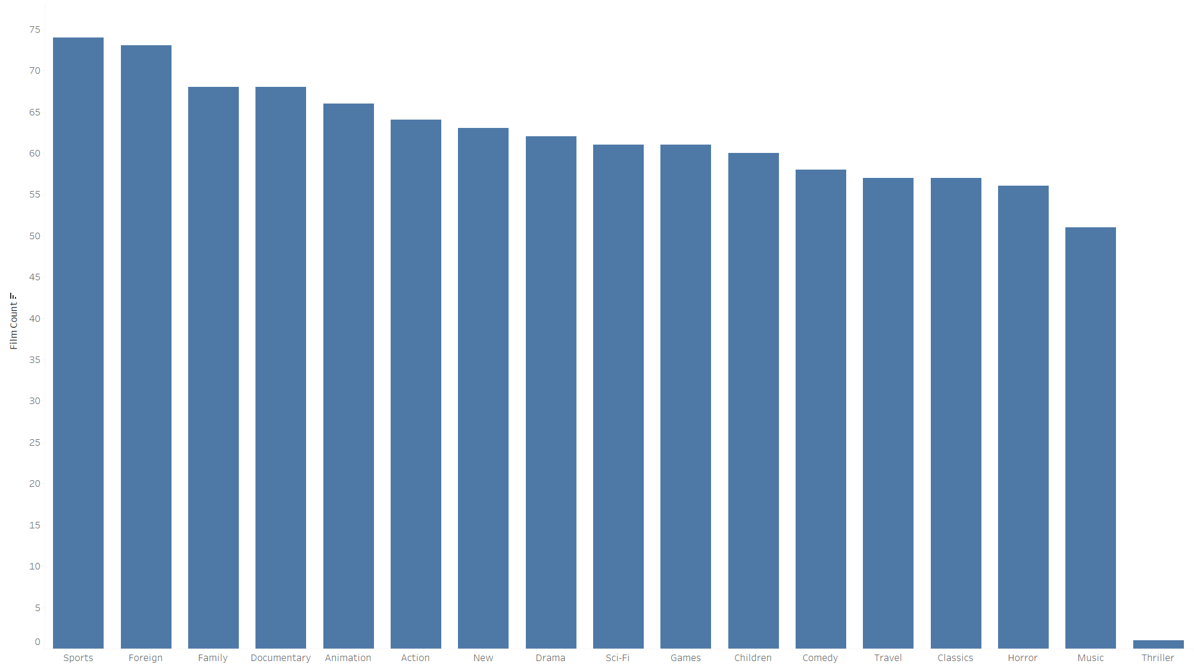
INVENTORY EVALUATION: TITLES PER GENRE
The inventory figures show that sports movies are well stocked alongside family and foreign movies. However, sports movies are far more in demand.
Thriller movies are poorly stocked and rarely rented.

Slide 10

KEY FINDINGS: MARKETS
Top Heavy Market:
The top 5 countries (India, China, the United States, Japan and Mexico) account for roughly 34% of the revenue.
Moving forward it’s going to become increasingly important to pay close attention to trends within these top 5 markets.

Slide 11
KEY FINDINGS: CUSTOMERS
Incentivization Program:
The top 10 spenders reveal an interesting aspect of the business model and that’s incentivization. A loyalty rewards program should be developed to further incentivize customers to continuously use our services. There could also be different tiers of rewards depending on the rental frequency. Ultimately, a higher quality catalog will prove to be more cost-effective and generate more revenue.

Slide 12
KEY FINDINGS: GENRE
Inventory Optimization:
The top performing genres don’t all have correlating inventory. While sports may be the most popular AND have the most inventory, this isn’t the case for the next popular genre, animation. Inventory should be optimized to maximize revenue from the highest performing genres while mitigating costs from licensing underperforming genres.

